Slide 1
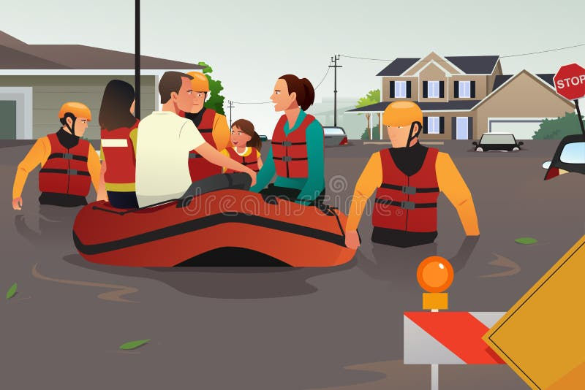
Flood Conditions
Ensure you safety at all times.
You can’t help others if you drown!

